Slide 1
Serverless Three-Tier Application

Slide 2
Description
Creating a Serverless Three-tier application by using AWS Lambda, Amazon RDS, and a website.
Presentation Tier :
A static website hosted on Amazon S3 that interacts with the backend.
Application Tier :
The business logic hosted on AWS Lambda functions, which process requests from the frontend through API Gateway.
Data Tier :
An Amazon RDS database to persist application data into a Table in the database.

Slide 3
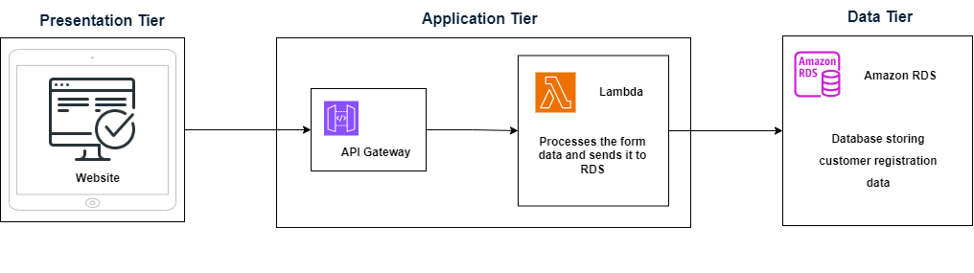
Flowchart of the Project

Slide 4
Services used for Project
1.AWS LAMBDA
1.Triggers
2.Cloud Watch Logs
2.S3 (Simple Storage Service)
1.Bucket
3.AWS RDS
1.Database
2.CloudWatch Metrics ,Logs & Events
4.Dbeaver
5.Postman

Slide 5
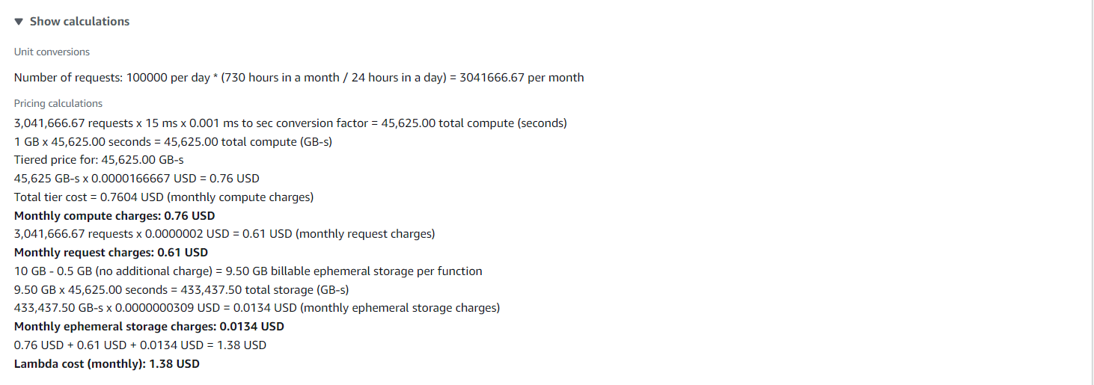
Pricing Pricing for AWS Lambda

Slide 6
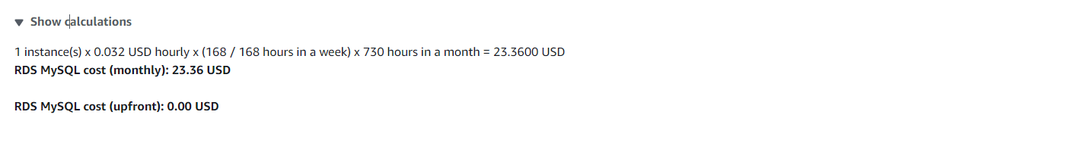
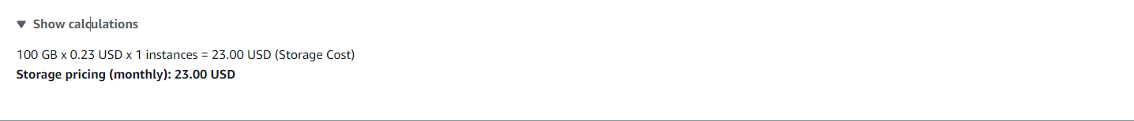
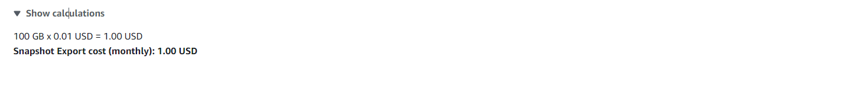
Pricing for AWS RDS

Slide 7
1.Sign-in to AWS Root Account
1.Search for AWS Management Console in Browser.
2.Open to the AWS Management Console.
3.Click on “Sign In to the Console”.
4.Choose “Root user” as the login method.
5.Enter Email and Password that is associated with your AWS root account.
6.Click on Sign in.

Slide 8
2.SettingUp Lambda
1.Search for Lambda in Search bar and open Lambda dashboard.
2.Click on Create Lambda Function , Assign a Name to Lambda & Runtime(Language) , Select Architecture as x86_64 , Click on Create a new role with basic lambda Permissions ,Create.
3.Click on Add Trigger , Search for API Gateway , in intent block checkmark on Create new API , in API type block select REST API , in Security dropdown select Open and Add it.
4.Click on Code in Lambda Function , Click on Upload from , select the ZIP file ,click on Upload to Upload the zip file in Lambda function & the code will be Deployed if not Click on Deploy.
5.Click on Configuration in Lambda Function to get API Endpoint & Copy it.
6.Open Postman , Select GET – Paste the API Endpoint, Click on Body – raw ,enter the data that has to Lambda & Click on send to Hit a request to Lambda Via API Gateway from postman.
7.Click on Monitor in Lambda Function ,Click on view Cloud Watch Logs & Open Log groups – “aws/lambda/qwert” to watch the logs of the created Lambda Function.
8.We can see the logs of Hitting Request to Lambda via API Gateway from Postman.
9.When we hit a request from postman through API Gateway’ end point then API Gateway will receive a request from postman with data & now it sends the data in raw body to Lambda Function.

Slide 9
3.Setting up S3 bucket
1.Search for S3 in Search bar and open S3 dashboard, Click on Create Bucket.
2.Select the bucket type as General Purpose, Give Unique bucket name to your bucket.
3.Checkmark on Block All public Access, Select ACL’s disable in Object Ownership & Create on Bucket.
4. Select the S3 Bucket ,Click on Objects ,Click on Upload & Choose the files from your PC.
5.Click on file to be uploaded (Html css js) and Click on Upload.
6.When we use the Object URL of this file in S3 bucket it will be only available for your Private users.
7.If the Public Users wants to access the website.
8.Select the file in S3 bucket ,Click on permissions, Uncheck mark the “Block all public access” to convert into Public ,Copy the Bucket ARN number & Click on Edit on Bucket Policy.

Slide 10
9.Select S3 bucket policy in Select Policy type ,Click on Allow Effects & Type * in Principles.
10.Check mark All Actions , Paste the Bucket ARN and enter /* after Bucket ARN.
11.Click On Add Statement & Click on Generate Policy.
12.Copy the code from AWS Policy and Paste it in Bucket Policy & Save it.
13.Bucket Policy edited Successfully.
14. Now public users can access our website by Object URL.

Slide 11
4.Setting Up RDS
1.Search for RDS in Search bar and open RDS dashboard, Click on Dashboard.
2.Click on Create Dashboard ,Select Standard Create in choose Database Creation Method & Select Engine of database.
3.Select Free Tier in Templates , Give Name to database, Create Username & Create Master Password for database in Credential Settings.
4.Select the Instance type, Storage & Select default VPC ,Checkmark Yes in Public Access.
5.Select default Security Group & Choose Availability Zone.
6.Enable Enhance Monitoring In Monitoring & Click on Create.
7.Database is created , Open database , Click on Connectivity & Security.
8.Click on VPC Security groups, Click on default group ,it will direct us to Security group details.
9.Click on Inbound rules , Click on edit Inbound rules & Click add rules – Select Custom TCP with port number 3306(Database port number) & Click on save.
10.Copy the Endpoint of the Database.

Slide 12
5.DBeaver
1.Install DBeaver & Open.
2.Click on connect to database logo, Search for our Database Engine & Click Next.
3.Paste the Database Endpoint URL in Server Host, Enter the Username, Password & Click on Test Connection.
4.Click on ok & then Finish to Established Connection between RDS Database & Dbeaver.
5.Expand Database-1,Right Click on New Database & Enter Database name Click on ok.
6.Expand formdata1,Right click on it ,Select SQL editor & Open SQL Script.
7.To create a table in formdata1 database , copy the query1 in the script.
8.Run the SQL query , Table has been created & Expand the tables in formdata1 database.
9.To display the table Copy the query2 in the Script & Run the query then table is displayed.
10.Table is Created.

Slide 13
Query-1
CREATE TABLE users (
email VARCHAR(255) NOT NULL,
firstName VARCHAR(100),
lastName VARCHAR(100),
phone VARCHAR(15),
birthday DATE, position VARCHAR(100),
courseLevel VARCHAR(50),
timeSlot VARCHAR(50),
PRIMARY KEY (email)
);
Query-2
SELECT * FROM users;

Slide 14
6.Connecting Lambda to RDS
1. Edit the following data in the python Lambda.
DB_HOST = 'database-2.c748oseu4sqb.us-east-1.rds.amazonaws.com‘(database endpoint)
DB_PORT = 3306
DB_USER = 'admin'
DB_PASSWORD = 'mypassword'
DB_NAME = ‘formdata1'

Slide 15
7.Monitoring
1.Monitoring Lambda Function
1. Cloud Watch Logs for Lambda.
2. Detailed information of Request from Website to RDS.
3. Some logs of Website taking Data Successfully.
4. Cloud Watch Metrics
2.Monitoring Database
1. RDS Logs & Events.
2. Cloud Watch Metrics of RDS.
3. Maintenance , Backup & Snapshots in RDS.

Slide 16
Conclusion
The serverless Three-tier application designed to handle form data and store it in Amazon RDS through AWS Lambda provides a robust and scalable architecture.
The use of AWS Lambda enables a fully managed, cost-efficient execution environment that scales automatically with the application's demands.
This serverless approach minimizes infrastructure management overhead and enhances agility.
Logging is integrated at each step to ensure comprehensive monitoring and troubleshooting capabilities.
These logs provide visibility into the application's performance, data flow, and error handling, enabling effective diagnostics and continuous improvement.
Overall, this serverless Three-tier architecture leverages AWS's powerful cloud services to deliver a scalable, efficient, and maintainable solution for form data processing and storage.

